Slide 1
Concepts and algorithms for mining patterns and associations
P.Krishna Reddy
IIIT, Hyderabad

Slide 2
Detailed Syllabus
Introduction (1.5 hour): Definition, KDD framework, Issues in data mining.
Data summarization (7.5 hrs): Data Types, Preprocessing, Characterization, Discrimination, data warehousing techniques (Multidimensional data model, Data warehousing architecture, Data cube computation and OLAP technology)
Mining patterns and associations (9 hours) Introduction to Association mining, a priori algorithm, FP growth, ECLAT, Overview of other algorithms, Pattern Evaluation, Coverage pattern mining, Multi-level mining, Quantitative association rules, Utility mining, Diverse Patterns, Coverage Patterns
Classification and regression (9hrs) (Overview, Decision tree induction, Over-fitting and under-fitting, Scalable decision tree algorithms, Bayesian Classification, Regression-based Prediction methods (9 hours)
Concepts and algorithms for clustering the data (9 hours) (Overview, Types of Data, K-means, Aglomerative clustering, Clustering algorithms (DBSCAN, BIRCH, CURE, ROCK, CHAMELEON)).
Outlier analysis and future trends (graph mining, spatio-temporal mining). (3 hours)

Slide 3
Presentation Outline
Basic concepts
  Frequent itemssets, Closed Itemsets, and Association Rules
Frequent itemset mining methods
    Apriori Algorithm
      Generating Association Rules from Frequent Itemsets
      Improving the Efficiency of Apriori
    A Pattern-Growth Approach
    Mining Frequent Itemsets Using the Vertical Data Format
    Mining Closed and Max Patterns
Which Patterns are interesting? Pattern Evaluation Methods
Summary

Slide 4
What Is Frequent Pattern Analysis?
Use case: You are talking to a customer who recently bought a PC and a digital camera from the store. What should you recommend to her next?
  Information about which products are frequently purchased by your customers following their purchases of a PC and a digital camera in sequence would be very helpful
  Frequent patterns and association rules are the knowledge that you want to mine in such a scenario.
Frequent pattern: a pattern (a set of items, subsequences, substructures, etc.) that occurs frequently in a data set
  First proposed by Agrawal, Imielinski, and Swami [AIS93] in the context of frequent itemsets and association rule mining
Motivation: Finding inherent regularities in data
  What products were often purchased together?— Beer and diapers?!
  What are the subsequent purchases after buying a PC?
  What kinds of DNA are sensitive to this new drug?
  Can we automatically classify web documents?
Applications
  Basket data analysis, cross-marketing, catalog design, sale campaign analysis, Web log (click stream) analysis, and DNA sequence analysis.

Slide 5
Why Is Freq. Pattern Mining Important?
Discloses an intrinsic and important property of data sets
Forms the foundation for many essential data mining tasks
  Association, correlation, and causality analysis
  Sequential, structural (e.g., sub-graph) patterns
  Pattern analysis in spatiotemporal, multimedia, time-series, and stream data
  Classification: associative classification
  Cluster analysis: frequent pattern-based clustering
  Data warehousing: iceberg cube and cube-gradient
  Semantic data compression: fascicles
  Broad applications

Slide 6
What Is Association Mining?
Association rule mining:
  Association rule mining searches for interesting relationships among items in a given data set.
  Example: 98% of people who purchase tires and auto accessories also get automotive services done
Applications:
  Basket data analysis, sales, catalog design, storage layout, customer segmentation based on buying pattern.

Slide 7
Association Rule: Basic Concepts
Given: (1) database of transactions, (2) each transaction is a list of items (purchased by a customer in a visit)
Find: all rules that correlate the presence of one set of items with that of another set of items
  E.g., 98% of people who purchase tires and auto accessories also get automotive services done
Applications
  * ⇒ Maintenance Agreement (What the store should do to boost Maintenance Agreement sales)
  Home Electronics ⇒ * (What other products should the store stocks up?)
  Attached mailing in direct marketing

Slide 8
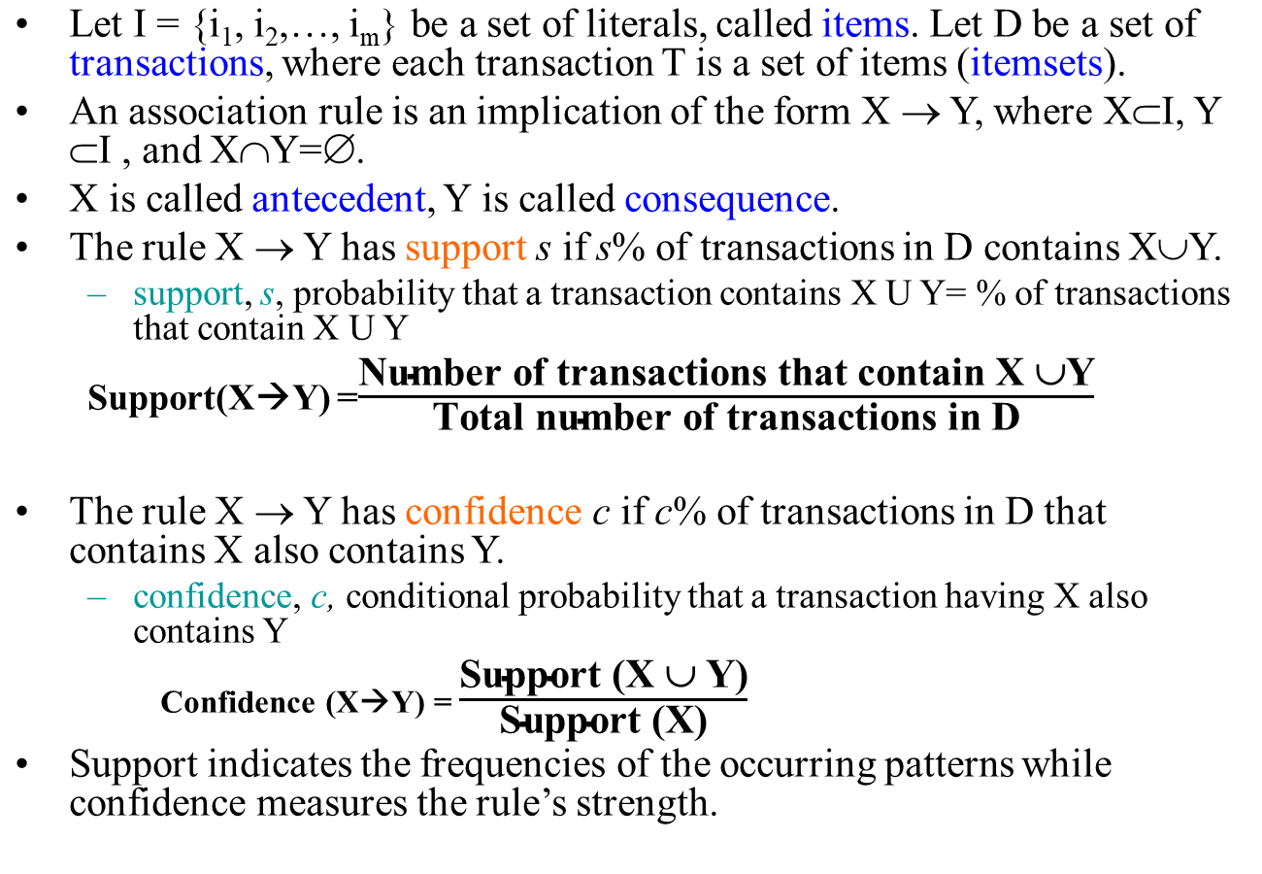
Formal Definition

Slide 9

Association Rule Mining
Given a set of transactions, find rules that will predict the occurrence of an item based on the occurrences of other items in the transaction
Market-Basket transactions
Example of Association Rules
{Diaper} → {Beer},
{Milk, Bread} → {Eggs,Coke},
{Beer, Bread} → {Milk},
Implication means co-occurrence, not causality!

Slide 10

Definition: Frequent Itemset
Itemset
  A collection of one or more items
    Example: {Milk, Bread, Diaper}
  k-itemset
    An itemset that contains k items
Support count (σ)
  Frequency of occurrence of an itemset
  E.g. σ({Milk, Bread,Diaper}) = 2
Support
  Fraction of transactions that contain an itemset
  E.g. s({Milk, Bread, Diaper}) = 2/5
Frequent Itemset
  An itemset whose support is greater than or equal to a minsup threshold

Slide 11



Association Rule: Example
Association Rule
  An implication expression of the form X → Y, where X and Y are itemsets
  Example:
  {Milk, Diaper} → {Beer}
Rule Evaluation Metrics
  Support (s)
    Fraction of transactions that contain both X and Y
  Confidence (c)
    Measures how often items in Y
    appear in transactions that
    contain X
Example:

Slide 12
Confidence of a rule
The confidence of a rule provides an accurate prediction on the association of the items in the rule.
The support of a rule indicates how frequent the rule is in the transactions.
Rules that have small support are uninteresting, since they do not describe large populations.

Slide 13
Association Rule Mining Task
Given a set of transactions T, the goal of association rule mining is to find all rules having
  support ≥ minsup threshold
  confidence ≥ minconf threshold
Brute-force approach:
  List all possible association rules
  Compute the support and confidence for each rule
  Prune rules that fail the minsup and minconf thresholds
  ⇒ Computationally prohibitive!

Slide 14
Mining Association Rules
Example of Rules:
{Milk,Diaper} → {Beer} (s=0.4, c=0.67)
{Milk,Beer} → {Diaper} (s=0.4, c=1.0)
{Diaper,Beer} → {Milk} (s=0.4, c=0.67)
{Beer} → {Milk,Diaper} (s=0.4, c=0.67)
{Diaper} → {Milk,Beer} (s=0.4, c=0.5)
{Milk} → {Diaper,Beer} (s=0.4, c=0.5)
Observations:
All the above rules are binary partitions of the same itemset:
{Milk, Diaper, Beer}
Rules originating from the same itemset have identical support but
can have different confidence
Thus, we may decouple the support and confidence requirements

Slide 15
Mining Association Rules
Two-step approach:
  Frequent Itemset Generation
    Generate all itemsets whose support ≥ minsup
  Rule Generation
    Generate high confidence rules from each frequent itemset, where each rule is a binary partitioning of a frequent itemset
Frequent itemset generation is still computationally expensive

Slide 16

Frequent Itemset Generation
Given d items, there are 2^{d} possible candidate itemsets

Slide 17

Frequent Itemset Generation
Brute-force approach:
  Each itemset in the lattice is a candidate frequent itemset
  Count the support of each candidate by scanning the database
  Match each transaction against every candidate
  Complexity ~ O(NMw) => Expensive since M = 2^{d} !!!

Slide 18
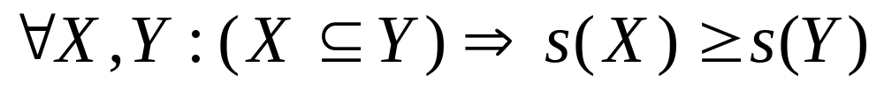
Reducing Number of Candidates
Apriori principle:
  If an itemset is frequent, then all of its subsets must also be frequent
Apriori principle holds due to the following property of the support measure:
  Support of an itemset never exceeds the support of its subsets
  This is known as the anti-monotone property of support

Slide 19


Illustrating Apriori Principle
Found to be Infrequent
Pruned supersets

Slide 20
Closed Patterns and Max-Patterns
A long pattern contains a combinatorial number of sub-patterns, e.g., {a₁, …, a₁₀₀} contains (₁₀₀¹) + (₁₀₀²) + … + (₁¹₀⁰₀⁰) = 2¹⁰⁰ – 1 = 1.27*10³⁰ sub-patterns!
Solution: Mine closed patterns and max-patterns instead
Closed Pattern:
  An itemset X is closed in a data set D if there exists no proper super-itemset Y such that Y has the same support count as X in D.
  (proposed by Pasquier, et al. @ ICDT’99)
Closed Frequent Pattern:
  An itemset X is a closed frequent pattern in set D if X is both closed and frequent in D.
Maximal Frequent Pattern:
  An itemset X is a max-frequent-pattern if X is frequent and there exists no frequent super-pattern Y כ X (proposed by Bayardo @ SIGMOD’98)
Closed pattern is a lossless compression of freq. patterns
  Reducing the # of patterns and rules

Slide 21
Closed Patterns and Max-Patterns
Exercise. DB = {<a₁, …, a₁₀₀>, < a₁, …, a₅₀>}
  Min_sup = 1.
What is the set of closed itemset?
  <a₁, …, a₁₀₀>: 1
  < a₁, …, a₅₀>: 2
What is the set of max-pattern?
  <a₁, …, a₁₀₀>: 1
What is the set of all patterns?
  !!

Slide 22
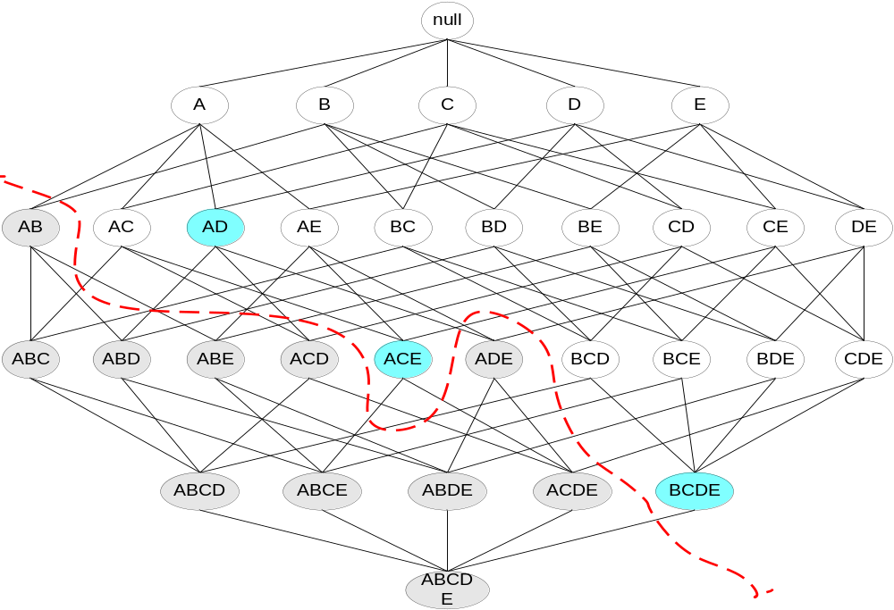
Maximal Frequent Itemset
An itemset is maximal frequent if none of its immediate supersets is frequent
Maximal Itemsets
Infrequent Itemsets
Border

Slide 23
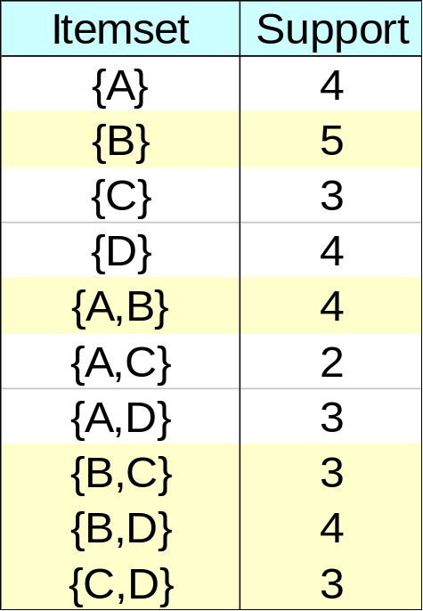
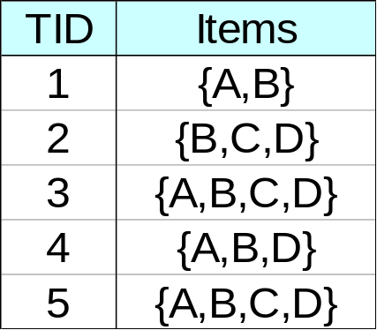
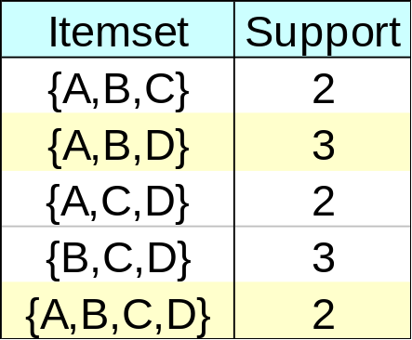
Closed Itemset
An itemset is closed if none of its immediate supersets has the same support as the itemset

Slide 24
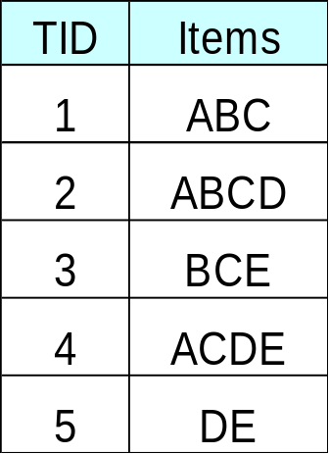
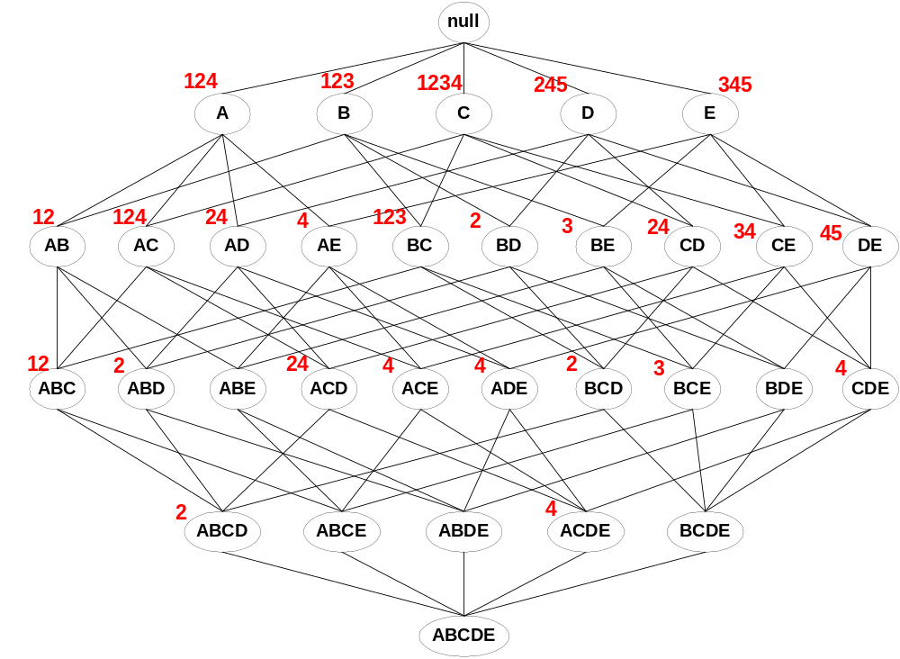
Maximal vs Closed Itemsets
Transaction Ids
Not supported by any transactions

Slide 25
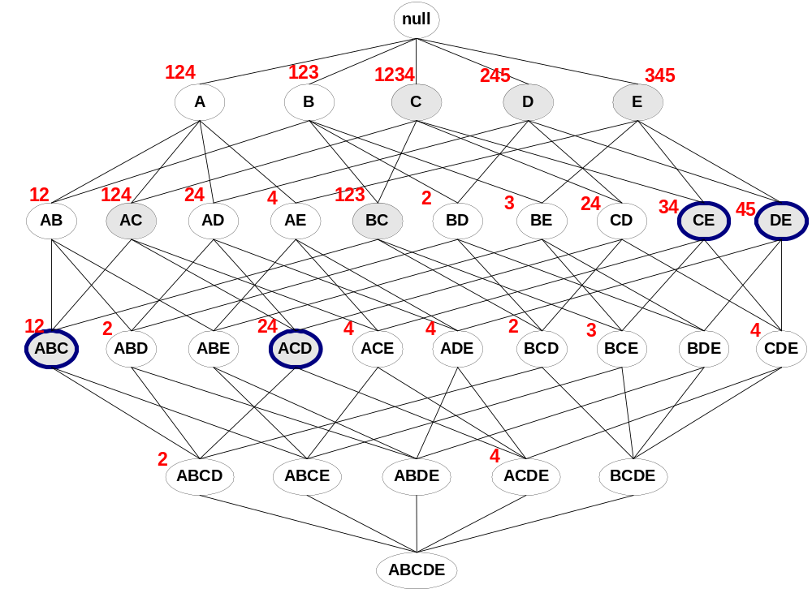
Maximal vs Closed Frequent Itemsets
Minimum support = 2
Closed but not maximal
Closed and maximal
# Closed = 9
# Maximal = 4

Slide 26
About Closed frequent itemsets and
Maximal frequent itemsets
Let C be the set of closed frequent itemsets for a data set D satisfying a minimum support threshold, min sup.
Let M be the set of maximal frequent itemsets for D satisfying min sup.
Suppose that we have the support count of each itemset in C and M.
Notice that C and its count information can be used to derive the whole set of frequent itemsets
  Thus, we say that C contains complete information regarding its corresponding frequent itemsets.
  On the other hand, M registers only the support of the maximal itemsets.
    We can only assert about the support, but exact count is not known

Slide 27
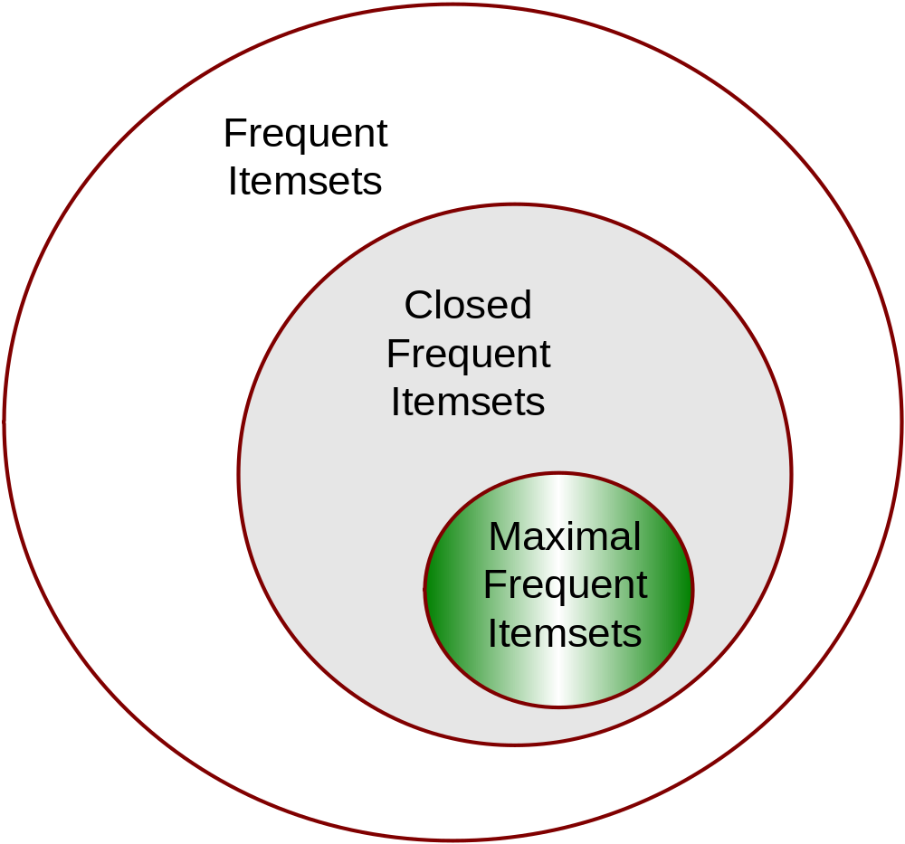
Maximal vs Closed Itemsets

Slide 28
Computational Complexity of Frequent Itemset Mining
How many itemsets are potentially to be generated in the worst case?
  The number of frequent itemsets to be generated is senstive to the minsup threshold
  When minsup is low, there exist potentially an exponential number of frequent itemsets
  The worst case: M^{N} where M: # distinct items, and N: max length of transactions

Slide 29
Frequent Itemset Generation Strategies
Reduce the number of candidates (M)
  Complete search: M=2^{d}
  Use pruning techniques to reduce M
Reduce the number of transactions (N)
  Reduce size of N as the size of itemset increases
  Used by DHP and vertical-based mining algorithms
Reduce the number of comparisons (NM)
  Use efficient data structures to store the candidates or transactions
  No need to match every candidate against every transaction

Slide 30
Presentation Outline
Basic concepts
  Frequent itemssets, Closed Itemsets, and Association Rules
Frequent itemset mining methods
    Apriori Algorithm
      Generating Association Rules from Frequent Itemsets
      Improving the Efficiency of Apriori
    A Pattern-Growth Approach
    Mining Frequent Itemsets Using the Vertical Data Format
    Mining Closed and Max Patterns
Which Patterns are interesting? Pattern Evaluation Methods
Summary

Slide 31
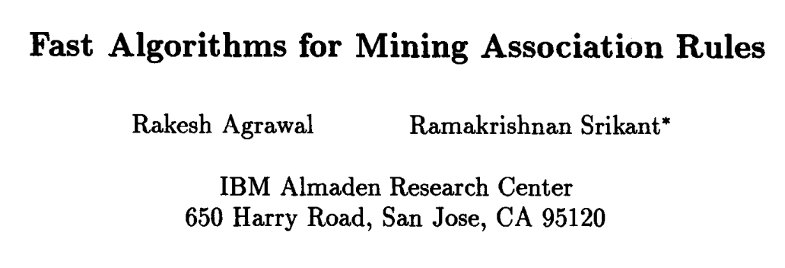
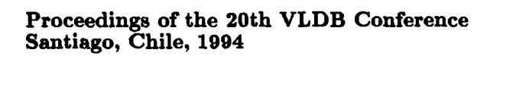

Slide 32
Apriori: A Candidate Generation & Test Approach
Apriori pruning principle: If there is any itemset which is infrequent, its superset should not be generated/tested!
Method:
  Initially, scan DB once to get frequent 1-itemset
  Generate length (k+1) candidate itemsets from length k frequent itemsets
  Test the candidates against DB
  Terminate when no frequent or candidate set can be generated

Slide 33
The Trick
Any subset of large itemset is large.
Therefore
To find large k-itemset
  Create candidates by combining large k-1 itemsets.
  Delete those that contain any subset that is not large.
Notes:
האלגוריתם השני לא משתמש בכלל בבסיס הנתונים למציאת התמיכה.

Slide 34
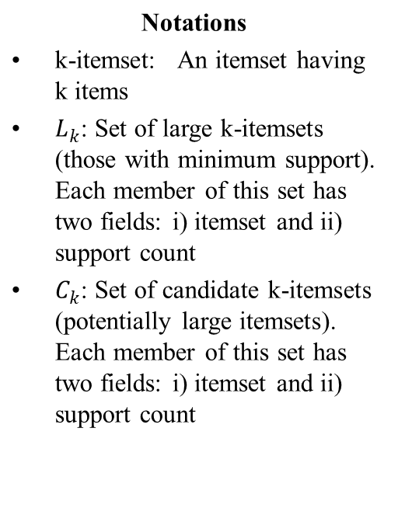
Apriori Algorithm
Candidate itemsets are generated using only the large itemsets of the previous pass without considering the transactions in the database.
The large itemset of the previous pass is joined with itself to generate all itemsets whose size is higher by 1.
Each generated itemset, that has a subset which is not large, is deleted. The remaining itemsets are the candidate ones.

Slide 35
The Apriori Algorithm—An Example
Sup_{min} = 2
Itemset | sup
{A} | 2
{B} | 3
{C} | 3
{D} | 1
{E} | 3
Database TDB
Itemset | sup
{A} | 2
{B} | 3
{C} | 3
{E} | 3
L₁
Tid | Items
10 | A, C, D
20 | B, C, E
30 | A, B, C, E
40 | B, E
C₁
1st scan
C₂
Itemset | sup
{A, B} | 1
{A, C} | 2
{A, E} | 1
{B, C} | 2
{B, E} | 3
{C, E} | 2
C₂
L₂
Itemset
{A, B}
{A, C}
{A, E}
{B, C}
{B, E}
{C, E}
Itemset | sup
{A, C} | 2
{B, C} | 2
{B, E} | 3
{C, E} | 2
2nd scan
C₃
Itemset
{B, C, E}
3rd scan
L₃
Itemset | sup
{B, C, E} | 2

Slide 36
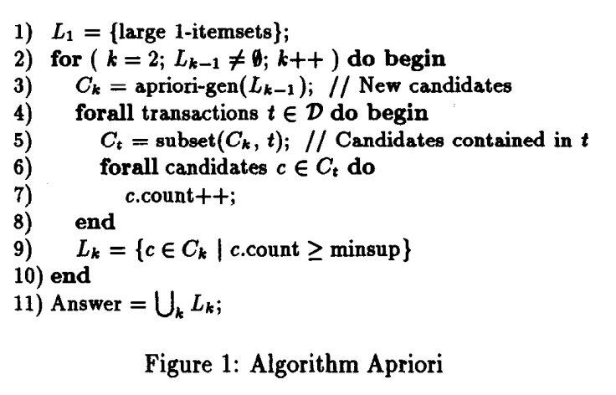
The Apriori Algorithm (Pseudo-Code)

Slide 37

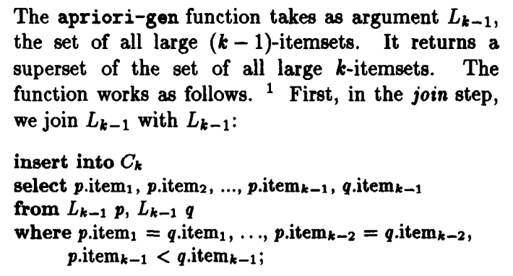

Slide 38
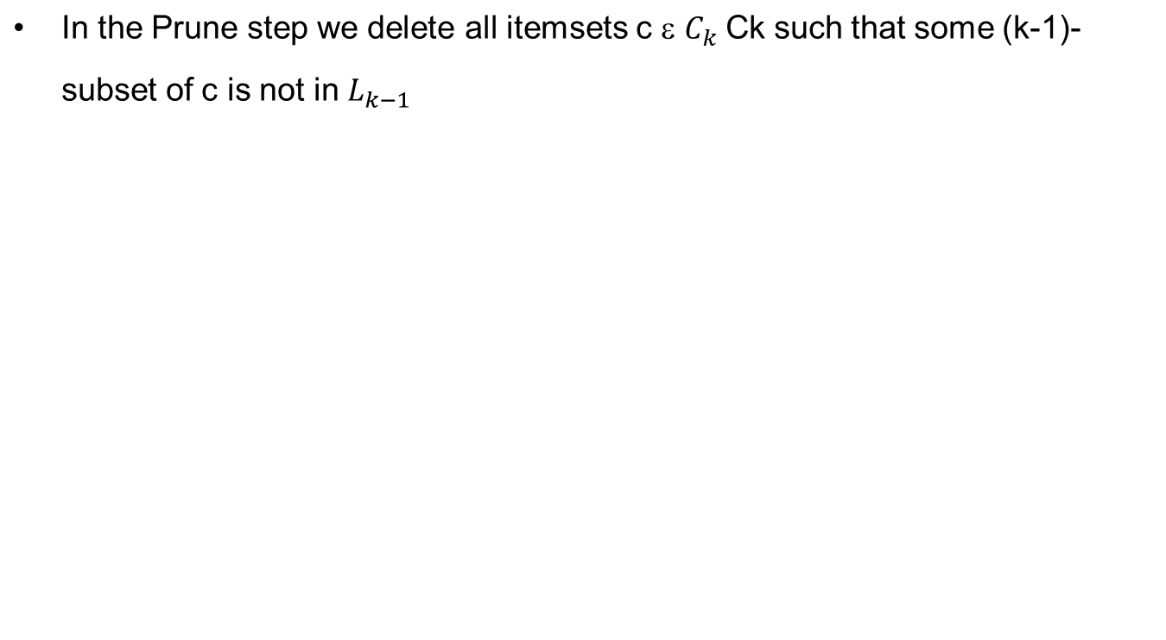
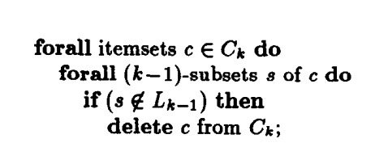
Prune Step

Slide 39
Self-joining and Pruning: Example
How to generate candidates?
  Step 1: self-joining L_{k}
  Step 2: pruning
Example of Candidate-generation
  L₃={abc, abd, acd, ace, bcd}
  Self-joining: L₃*L₃
    abcd from abc and abd
    acde from acd and ace
  Pruning:
    acde is removed because ade is not in L₃
  C₄ = {abcd}

Slide 40
How to Count Supports of Candidates?
Why counting supports of candidates a problem?
  The total number of candidates can be very huge
  One transaction may contain many candidates
Method:
  Candidate itemsets are stored in a hash-tree
  Leaf node of hash-tree contains a list of itemsets and counts
  Interior node contains a hash table
  Subset function: finds all the candidates contained in a transaction

Slide 41
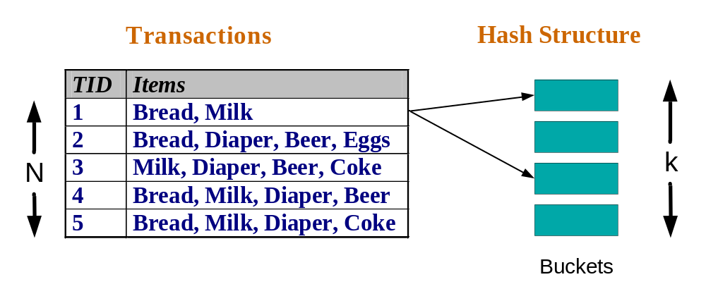
Reducing Number of Comparisons
Candidate counting:
  Scan the database of transactions to determine the support of each candidate itemset
  To reduce the number of comparisons, store the candidates in a hash structure
    Instead of matching each transaction against every candidate, match it against candidates contained in the hashed buckets

Slide 42
How to Count Supports of Candidates?
Candidate itemsets Ck are stored in a hash-tree.
A node of the hash-tree either contains a list of itemsets (a leaf node) or a hash table (an interior node).
In an interior node, each bucket of the hash table points to another node. The root of the hash-tree is defined to be at depth 1.
An interior node at depth d points to nodes at depth d+1.
Itemsets are stored in the leaves.
When we add an itemset c, we start from the root and go down the tree until we reach a leaf. At an interior node at depth d, we decide which branch to follow by applying a hash function to the d’th item of the itemset.
All nodes are initially created as leaf nodes. When the number of itemsets in a leaf node exceeds a specified threshold, the leaf node is converted to an interior node.

Slide 43
How to Count Supports of Candidates?
Starting from the root node, the subset function finds all the candidates contained in a transaction t as follows.
  If we are at a leaf, we finds which of the itemsets in the leaf are contained in t and add references to them to the answer set.
  If we are at an interior node and we have reached it by hashing the item i, we hash on each item that comes after i in t and recursively apply this procedure to the node in the corresponding bucket. For the root node, we hash on every item in t.

Slide 44
How to Count Supports of Candidates?
To see why the subset function returns the desired set of references, consider what happens at the root node.
  For any itemset c contained in transaction t, the first item of c must be in t.
  At the root, by hashing on every item in t, we ensure that we only ignore itemsets that start with an item not in t. Similar arguments apply at lower depths.
  The only additional factor is that, since the items in any itemset are ordered, if we reach the current node by hashing the item i, we only need to consider the items in t that occur after i.
  If k is the size of a candidate itemset in the hash-tree, we can find in O(k) time whether the itemset is contained in a transaction by using a temporary bitmap. Each bit of the bitmap corresponds an item. The bitmap is created once for the data structure, and reinitialized for each transaction. This initialization takes O(size(transaction)) time for each transaction.

Slide 45
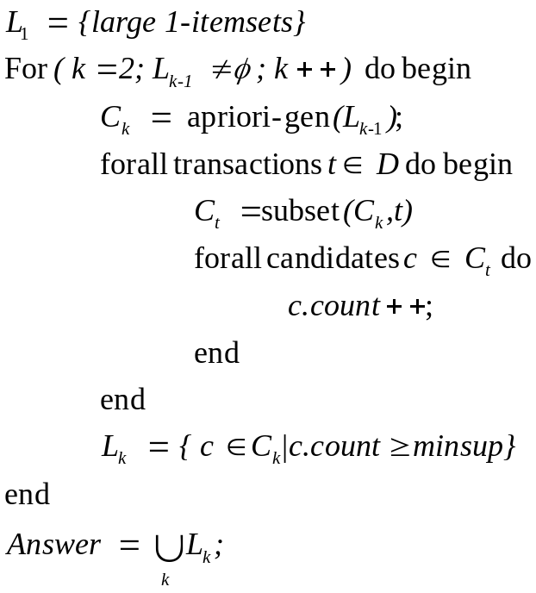
Subset Function
Candidate itemsets - C_{k} are stored in a hash-tree
Finds in O(k) time whether a candidate itemset of size k is contained in transaction t.
Total time O(max(k,size(t))
Notes:
עץ האש
עלים – itemsets
צמתים פנימיים – hash table
לבדוק!!!

Slide 46
Generate Hash Tree
Suppose you have 15 candidate itemsets of length 3:
{1 4 5}, {1 2 4}, {4 5 7}, {1 2 5}, {4 5 8}, {1 5 9}, {1 3 6}, {2 3 4}, {5 6 7}, {3 4 5}, {3 5 6}, {3 5 7}, {6 8 9}, {3 6 7}, {3 6 8}
You need:
Hash function
Max leaf size: max number of itemsets stored in a leaf node (if number of candidate itemsets exceeds max leaf size, split the node)
Hash function
2 3 4
5 6 7
3,6,9
1,4,7
1 4 5
3 4 5
3 5 6
3 5 7
6 8 9
3 6 7
3 6 8
1 3 6
2,5,8
1 2 4
4 5 7
1 2 5
4 5 8
1 5 9

Slide 47
Association Rule Discovery: Hash tree
Hash Function
Candidate Hash Tree
1,4,7
3,6,9
2,5,8
2 3 4
5 6 7
1 4 5
1 3 6
3 4 5
3 5 6
3 6 7
Hash on 1, 4 or 7
3 5 7
3 6 8
1 2 4
1 5 9
6 8 9
1 2 5
4 5 7
4 5 8

Slide 48
Association Rule Discovery: Hash tree
Hash Function
Candidate Hash Tree
1,4,7
3,6,9
2,5,8
2 3 4
5 6 7
1 4 5
1 3 6
3 4 5
3 5 6
3 6 7
Hash on 2, 5 or 8
3 5 7
3 6 8
1 2 4
1 5 9
6 8 9
1 2 5
4 5 7
4 5 8

Slide 49
Association Rule Discovery: Hash tree
Hash Function
Candidate Hash Tree
1,4,7
3,6,9
2,5,8
2 3 4
5 6 7
1 4 5
1 3 6
3 4 5
3 5 6
3 6 7
Hash on 3, 6 or 9
3 5 7
3 6 8
1 2 4
1 5 9
6 8 9
1 2 5
4 5 7
4 5 8

Slide 50
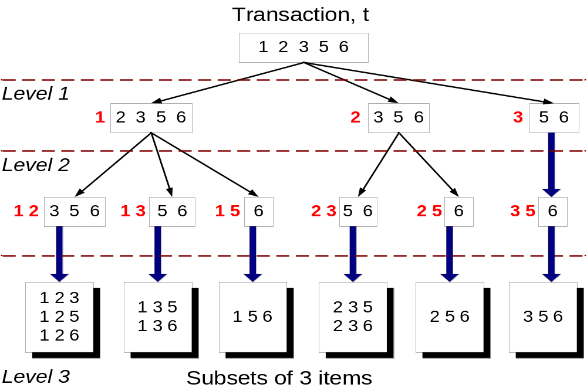
Subset Operation
Given a transaction t, what are the possible subsets of size 3?

Slide 51
Subset Operation Using Hash Tree
1 2 3 5 6
transaction
Hash Function
1 +
2 3 5 6
2 +
3 5 6
1,4,7
3,6,9
3 +
5 6
2,5,8
2 3 4
5 6 7
1 4 5
1 3 6
3 4 5
3 5 6
3 6 7
3 5 7
3 6 8
1 2 4
1 2 5
1 5 9
6 8 9
4 5 7
4 5 8

Slide 52
Subset Operation Using Hash Tree
1 2 3 5 6
transaction
Hash Function
1 +
2 3 5 6
2 +
3 5 6
1,4,7
3,6,9
1 2 +
3 5 6
3 +
5 6
2,5,8
1 3 +
5 6
2 3 4
1 5 +
6
5 6 7
1 4 5
1 3 6
3 4 5
3 5 6
3 6 7
3 5 7
3 6 8
1 2 4
1 2 5
1 5 9
6 8 9
4 5 7
4 5 8

Slide 53
Subset Operation Using Hash Tree
1 2 3 5 6
transaction
Hash Function
1 +
2 3 5 6
2 +
3 5 6
1,4,7
3,6,9
1 2 +
3 5 6
3 +
5 6
2,5,8
1 3 +
5 6
2 3 4
1 5 +
6
5 6 7
1 4 5
1 3 6
3 4 5
3 5 6
3 6 7
3 5 7
3 6 8
1 2 4
1 2 5
1 5 9
6 8 9
4 5 7
4 5 8
Match transaction against 11 out of 15 candidates

Slide 54
Example: Counting Supports of Candidates
Subset function
Transaction: 1 2 3 5 6
3,6,9
1,4,7
2,5,8
1 + 2 3 5 6
1 3 + 5 6
2 3 4
5 6 7
1 4 5
3 4 5
3 5 6
3 5 7
6 8 9
3 6 7
3 6 8
1 3 6
1 2 + 3 5 6
1 2 4
4 5 7
1 2 5
4 5 8
1 5 9

Slide 55
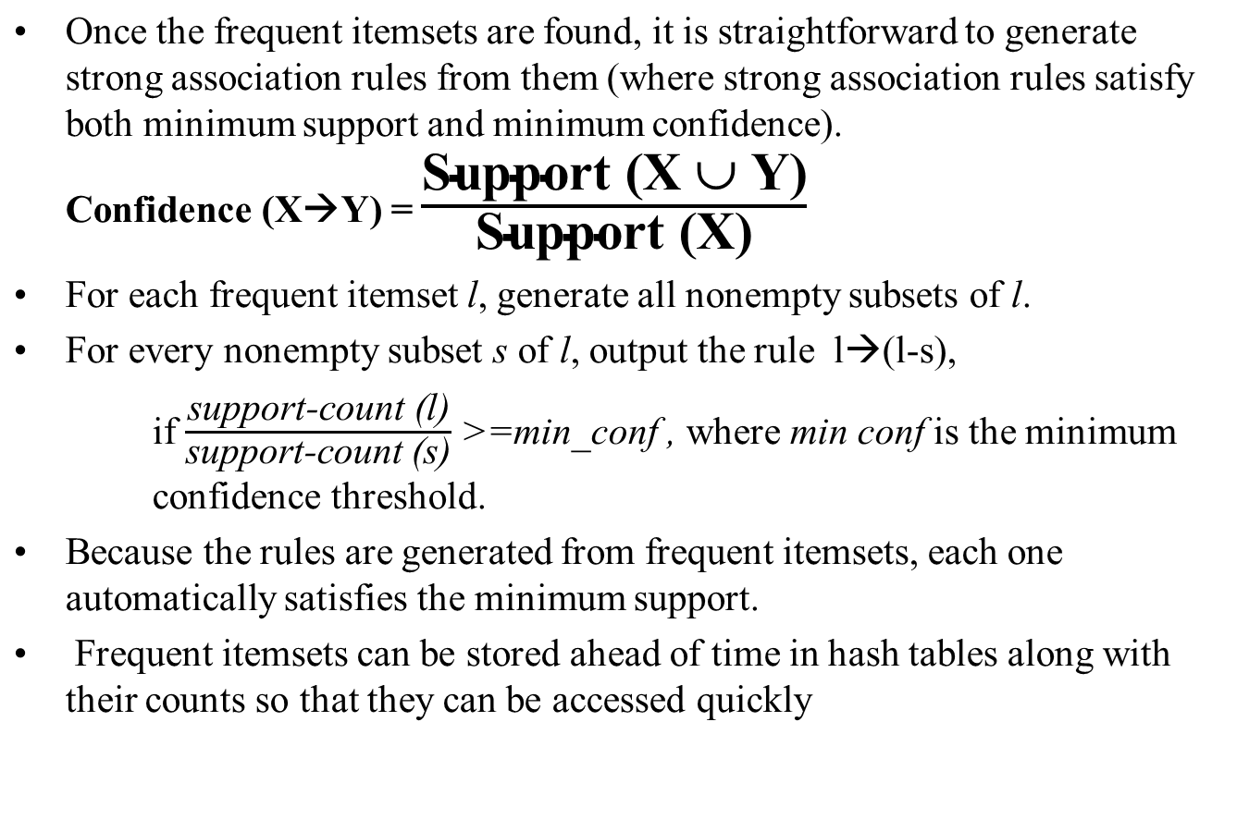
Generating Association Rules

Slide 56
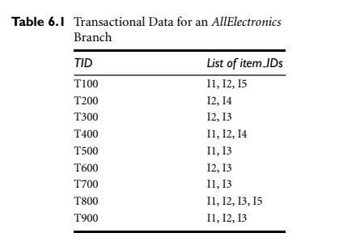
Example
The data contain frequent itemset X (I1, I2, I5). What are the association rules that can be generated from X?
Generate the nonempty subsets
of X are {I1, I2}, {I1, I5}, {I2, I5}, {I1}, {I2}, and {I5}.
The resulting association rules are
  {I1, I2}→{I5}= confidence=2/4=50%
  {I1, I5}→{I2}=2/2=100%
  {I2, I5}→ {I1}=2/2=100%
  {I1}→{I2,I5}= 2/6=33%
….
…
If minimum confidence =70%, second and third are potential rules

Slide 57
Presentation Outline
Basic concepts
  Frequent itemssets, Closed Itemsets, and Association Rules
Frequent itemset mining methods
    Apriori Algorithm
      Generating Association Rules from Frequent Itemsets
      Improving the Efficiency of Apriori
    A Pattern-Growth Approach
    Mining Frequent Itemsets Using the Vertical Data Format
    Mining Closed and Max Patterns
Which Patterns are interesting? Pattern Evaluation Methods
Summary

Slide 58
Further Improvement of the Apriori Method
Apriori: Major computational challenges
  Multiple scans of transaction database
  Huge number of candidates
  Tedious workload of support counting for candidates
Improving Apriori: general ideas
  Reduce passes of transaction database scans
  Shrink number of candidates
  Facilitate support counting of candidates

Slide 59
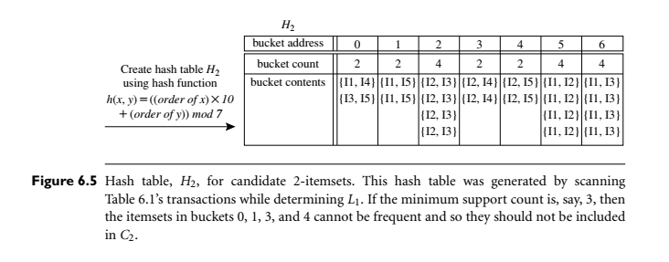
DHP (Direct Hashing and Pruning):
Reduce the Number of Candidates
Use of hash to reduce the size of candidate k-itemsets, Ck, for k > 1.
For example, when scanning each transaction in the database to generate the frequent 1-itemsets, L1, we can generate all the 2-itemsets for each transaction, hash (i.e., map) them into the different buckets of a hash table structure, and increase the corresponding bucket counts.
A 2-itemset with a corresponding bucket count in the hash table that is below the support threshold cannot be frequent (especially when k=2)
J. Park, M. Chen, and P. Yu. An effective hash-based algorithm for mining association rules. SIGMOD’95

Slide 60
Transaction Reduction
Reducing the number of transactions scanned in future iterations):
A transaction that does not contain any frequent k-itemsets cannot contain any
frequent (k+1)-itemsets.
Therefore, such a transaction can be marked or removed
from further consideration because subsequent database scans for j-itemsets, where

Slide 61
Partition: Scan Database Only Twice
Any itemset that is potentially frequent in DB must be frequent in at least one of the partitions of DB
  Scan 1: partition database and find local frequent patterns
  Scan 2: consolidate global frequent patterns
A. Savasere, E. Omiecinski and S. Navathe, VLDB’95
DB₁
+
DB₂
+
+
DB_{k}
= DB
sup₁(i) < σDB₁
sup₂(i) < σDB₂
sup_{k}(i) < σDB_{k}
sup(i) < σDB

Slide 62
Sampling for Frequent Patterns
Select a sample of original database, mine frequent patterns within sample using Apriori
Scan database once to verify frequent itemsets found in sample, only borders of closure of frequent patterns are checked
  Example: check abcd instead of ab, ac, …, etc.
Scan database again to find missed frequent patterns
H. Toivonen. Sampling large databases for association rules. In VLDB’96

Slide 63
Dynamic Itemset Counting (DIC): Reduce Number of Scans
ABCD
Once both A and D are determined frequent, the counting of AD begins
Once all length-2 subsets of BCD are determined frequent, the counting of BCD begins
ABC
ABD
ACD
BCD
AB
AC
BC
AD
BD
CD
Transactions
1-itemsets
A
B
C
D
Apriori
2-itemsets
…
{}
Itemset lattice
1-itemsets
2-items
S. Brin R. Motwani, J. Ullman, and S. Tsur. Dynamic itemset counting and implication rules for market basket data. SIGMOD’97
DIC
3-items

Slide 64
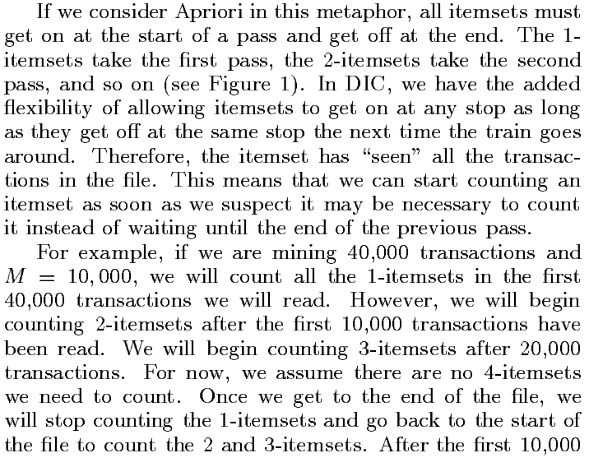
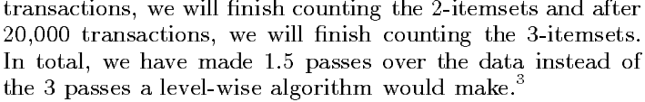
Basic Idea of DIC

Slide 65
Presentation Outline
Basic concepts
  Frequent itemssets, Closed Itemsets, and Association Rules
Frequent itemset mining methods
    Apriori Algorithm
      Generating Association Rules from Frequent Itemsets
      Improving the Efficiency of Apriori
    A Pattern-Growth Approach
    Mining Frequent Itemsets Using the Vertical Data Format
    Mining Closed and Max Patterns
Which Patterns are interesting? Pattern Evaluation Methods
Summary

Slide 66
Mining Frequent Patterns without Candidate Generation
Proc. 2000 ACM-SIGMOD Int. Conf. on Management of Data (SIGMOD'00), Dallas, TX, May 2000.
Jiawei Han, Jian Pei, and Yiwen Yin
(FP Tree method)

Slide 67
Pattern-Growth Approach: Mining Frequent Patterns Without Candidate Generation
Bottlenecks of the Apriori approach
  Breadth-first (i.e., level-wise) search
  Candidate generation and test
    Often generates a huge number of candidates
The FPGrowth Approach (J. Han, J. Pei, and Y. Yin, SIGMOD’ 00)
  Depth-first search
  Avoid explicit candidate generation
Major philosophy: Grow long patterns from short ones using local frequent items only
  “abc” is a frequent pattern
  Get all transactions having “abc”, i.e., project DB on abc: DB|abc
  “d” is a local frequent item in DB|abc → abcd is a frequent pattern

Slide 68
Main Concepts of FP-growth
F-list
FP tree
Header table
Conditional pattern bases
Conditional FP-trees

Slide 69
Construct FP-tree from a Transaction Database
TID Items bought (ordered) frequent items
100 {f, a, c, d, g, i, m, p} {f, c, a, m, p}
200 {a, b, c, f, l, m, o} {f, c, a, b, m}
300 {b, f, h, j, o, w} {f, b}
400 {b, c, k, s, p} {c, b, p}
500 {a, f, c, e, l, p, m, n} {f, c, a, m, p}
min_support = 3
{}
Header Table
Item frequency head
f 4
c 4
a 3
b 3
m 3
p 3
Scan DB once, find frequent 1-itemset (single item pattern)
Sort frequent items in frequency descending order, f-list
Scan DB again, construct FP-tree
f:4
c:1
c:3
b:1
b:1
a:3
p:1
m:2
b:1
F-list = f-c-a-b-m-p
p:2
m:1

Slide 70
Partition Patterns and Databases
Frequent patterns can be partitioned into subsets according to f-list
  F-list = f-c-a-b-m-p
  Patterns containing p
  Patterns having m but no p
  …
  Patterns having c but no a nor b, m, p
  Pattern f
Completeness and non-redundency

Slide 71
Find Patterns Having P From P-conditional Database
Starting at the frequent item header table in the FP-tree
Traverse the FP-tree by following the link of each frequent item p
Accumulate all of transformed prefix paths of item p to form p’s conditional pattern base
{}
Header Table
Item frequency head
f 4
c 4
a 3
b 3
m 3
p 3
f:4
c:1
Conditional pattern bases
item cond. pattern base
c f:3
a fc:3
b fca:1, f:1, c:1
m fca:2, fcab:1
p fcam:2, cb:1
c:3
b:1
b:1
a:3
p:1
m:2
b:1
p:2
m:1

Slide 72
From Conditional Pattern-bases to Conditional FP-trees
For each pattern-base
  Accumulate the count for each item in the base
  Construct the FP-tree for the frequent items of the pattern base
m-conditional pattern base:
  fca:2, fcab:1
{}
Header Table
Item frequency head
f 4
c 4
a 3
b 3
m 3
p 3
f:4
c:1
All frequent patterns relate to m
m,
fm, cm, am,
fcm, fam, cam,
fcam
{}
c:3
b:1
b:1

f:3

a:3
p:1
m:2
b:1
c:3
p:2
m:1
a:3
m-conditional FP-tree

Slide 73
Recursion: Mining Each Conditional FP-tree
{}
{}
Cond. pattern base of “am”: (fc:3)
f:3
c:3
f:3
am-conditional FP-tree
c:3
{}
Cond. pattern base of “cm”: (f:3)
a:3
f:3
m-conditional FP-tree
cm-conditional FP-tree
{}
Cond. pattern base of “cam”: (f:3)
f:3
cam-conditional FP-tree

Slide 74
Presentation Outline
Basic concepts
  Frequent itemssets, Closed Itemsets, and Association Rules
Frequent itemset mining methods
    Apriori Algorithm
      Generating Association Rules from Frequent Itemsets
      Improving the Efficiency of Apriori
    A Pattern-Growth Approach
    Mining Frequent Itemsets Using the Vertical Data Format
    Mining Closed and Max Patterns
Which Patterns are interesting? Pattern Evaluation Methods
Summary

Slide 75
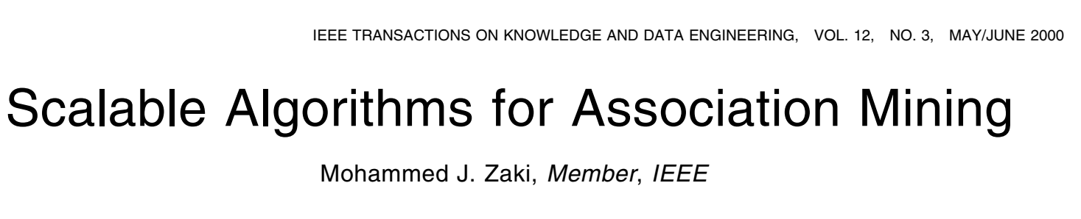

Slide 76
ECLAT: Mining by Exploring Vertical Data Format
(ECLAT: Equivalence CLAss Transformation)
Transform the horizontally formatted data into the vertical format by scanning the data set once.
The support count of an itemset is simply the length of the TID set of the itemset.
  Starting with k = 1, the frequent k-itemsets can be used to construct the candidate (k +1)-itemsets based on the Apriori property.

Slide 77
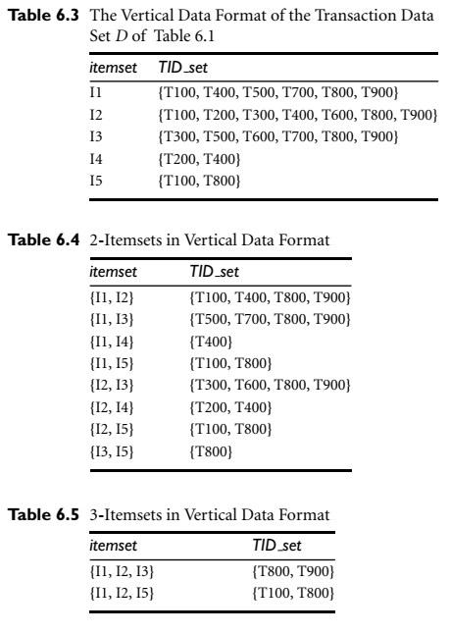
Example:
The minimum support count is 2.
10 intersections performed in total, which lead to eight
nonempty 2-itemsets.
Notice that because the itemsets {I1, I4} and {I3, I5} each contain only one transaction, they do not belong to the set of frequent
2-itemsets.
Based on the Apriori property, a given 3-itemset is a candidate 3-itemset only if every
one of its 2-itemset subsets is frequent. The candidate generation process here will generate only two 3-itemsets: {I1, I2, I3} and {I1, I2, I5}.
By intersecting the TID sets of any
two corresponding 2-itemsets of these candidate 3-itemsets, we can extract three itemsets.
There are only two frequent 3-itemsets: {I1, I2, I3: 2} and {I1, I2, I5: 2}.

Slide 78
About ECLAT
Advantages
  Exploits apriori property
  Scan the database only once
Negative
  the TID sets can be quite long, taking substantial memory space as well as computation time for intersecting the long sets.
Notion of Diffset is proposed
  Keep track of only Diffset
  keeps track of only the differences of the TID sets of a (k- 1)-itemset and a corresponding k-itemset.
    For instance, in Example 6.6 we have {I1}={T100, T400, T500, T700, T800, T900} and {I1, I2}= {T100, T400, T800, T900}. The diffset between the two is diffset({I1, I2}, {I1}})= {T500, T700}.

Slide 79
Presentation Outline
Basic concepts
  Frequent itemssets, Closed Itemsets, and Association Rules
Frequent itemset mining methods
    Apriori Algorithm
      Generating Association Rules from Frequent Itemsets
      Improving the Efficiency of Apriori
    A Pattern-Growth Approach
    Mining Frequent Itemsets Using the Vertical Data Format
    Mining Closed and Max Patterns
Which Patterns are interesting? Pattern Evaluation Methods
Summary

Slide 80
Basic Idea
Naïve approach
  Mine complete set of frequent item sets
  Filter each frequent itemset which is a subset of another frequent itemset or caries the same support of the existing frequent itemset.
  High complexity
Recommended methodology
  Search for closed itemsets directly during the mining process.
  Prune the search space as soon as we find the closed itemsets.
List of papers
  J. Pei, J. Han & R. Mao. “CLOSET: An Efficient Algorithm for Mining Frequent Closed Itemsets", DMKD’00.
  R. Bayardo. Efficiently mining long patterns from databases. SIGMOD’98

Slide 81
Presentation Outline
Basic concepts
  Frequent itemssets, Closed Itemsets, and Association Rules
Frequent itemset mining methods
    Apriori Algorithm
      Generating Association Rules from Frequent Itemsets
      Improving the Efficiency of Apriori
    A Pattern-Growth Approach
    Mining Frequent Itemsets Using the Vertical Data Format
    Mining Closed and Max Patterns
Which Patterns are interesting? Pattern Evaluation Methods
Summary

Slide 82
Strong Rules always may not be interesting
Example
  Buys(X, computer game) →buys(X, videos)
  Support=40%, confidence=66%
  Strong rule
This rule is uninteresting, because the probability of purchasing videos is 75%
Normally, computer games and videos are negatively correlated.
Purchase of one decreases the chances of purchase of the other.
So support/confidence framework may be misleading.
We need measures to measure real strength of the correlation and implication.

Slide 83
Correlation rules
A→B(support, confidence, correlation)
Lift is the simple correlation measure
Lift(A,B)=P(AUB)/P(A)P(B)
  < 1 negatively correlated
    It means occurrence of one will lead to absence of the other
  >1
    Positively correlated
  =1
    A and B are independent
Chi-square test is another correlation measure.
  It tests the hypothesis that both are independent

Slide 84
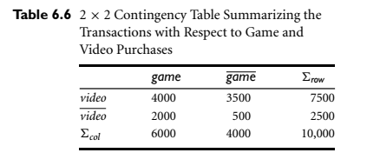
Example
Lift (game → videos)=0.40/0.60*0.75=0.89
= <1 negatively correlated.
Numerator: likelihood of purchasing both
Denominator: likelihood of independent purchases.

Slide 85
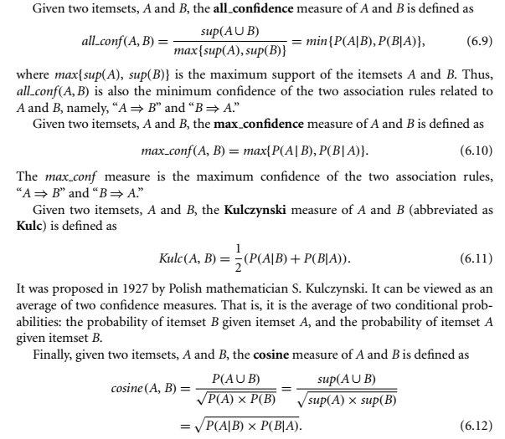

Slide 86
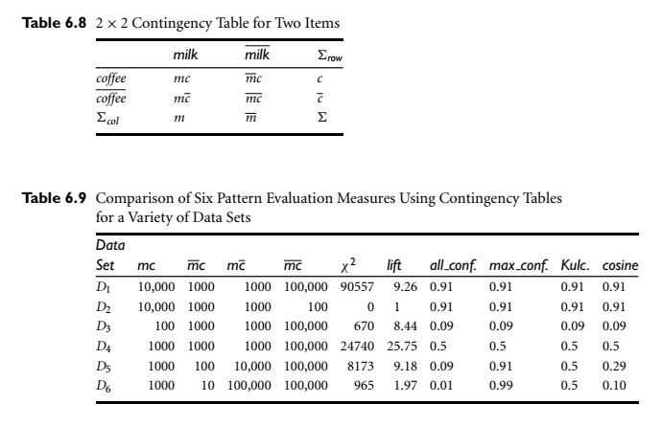
Which one is better?
We introduced six measures? Which one is best in assessing the pattern relationship?

Slide 87
M and C
  are positively correlated in D1 and D2
  Are negatively associated in D3
  Neutral in D4
Lift and chi-square produce different results for D1 and D2 because of
In real world applications, is huge and unstable.
So a good measure should not be effected by
D3: other measures are OK but lift and chisquare contradict
D4, lift and chisquare show high correlation, others indicate neutral

Slide 88
Reason for bad performance of lift and chi square
  Null transactions: A null transaction does not contain the items being examined
A measure should be independent of null transactions

Slide 89


Which Null-Invariant Measure Is Better?
IR (Imbalance Ratio): measure the imbalance of two itemsets A and B in rule implications
Kulczynski and Imbalance Ratio (IR) together present a clear picture for all the three datasets D₄ through D₆
  D₄ is balanced & neutral
  D₅ is imbalanced & neutral
  D₆ is very imbalanced & neutral

Slide 90
Presentation Outline
Basic concepts
  Frequent itemssets, Closed Itemsets, and Association Rules
Frequent itemset mining methods
    Apriori Algorithm
      Generating Association Rules from Frequent Itemsets
      Improving the Efficiency of Apriori
    A Pattern-Growth Approach
    Mining Frequent Itemsets Using the Vertical Data Format
    Mining Closed and Max Patterns
Which Patterns are interesting? Pattern Evaluation Methods
Summary

